Slide 1
Spring Bean LifeCycle
author: Jacky
time:2023-11-20

Slide 2
Basic LiftCycle
Beanfactory
instantiation
populateBean
invokeAwareMethods
postMethods
BeanfactoryPostProcessor
invokeInitMethods
BeanPostProcessor
aftermethods
BeanDefinitionReader
BeanDefinition
Complete object
destroy

Slide 3
Bean Defination
Back
xml
<bean id="..." class="...">
<!-- collaborators and configuration for this bean go here -->
</bean>
annottion
@Component, @Service, and @Controller
other
yml and properties etc.

Slide 4
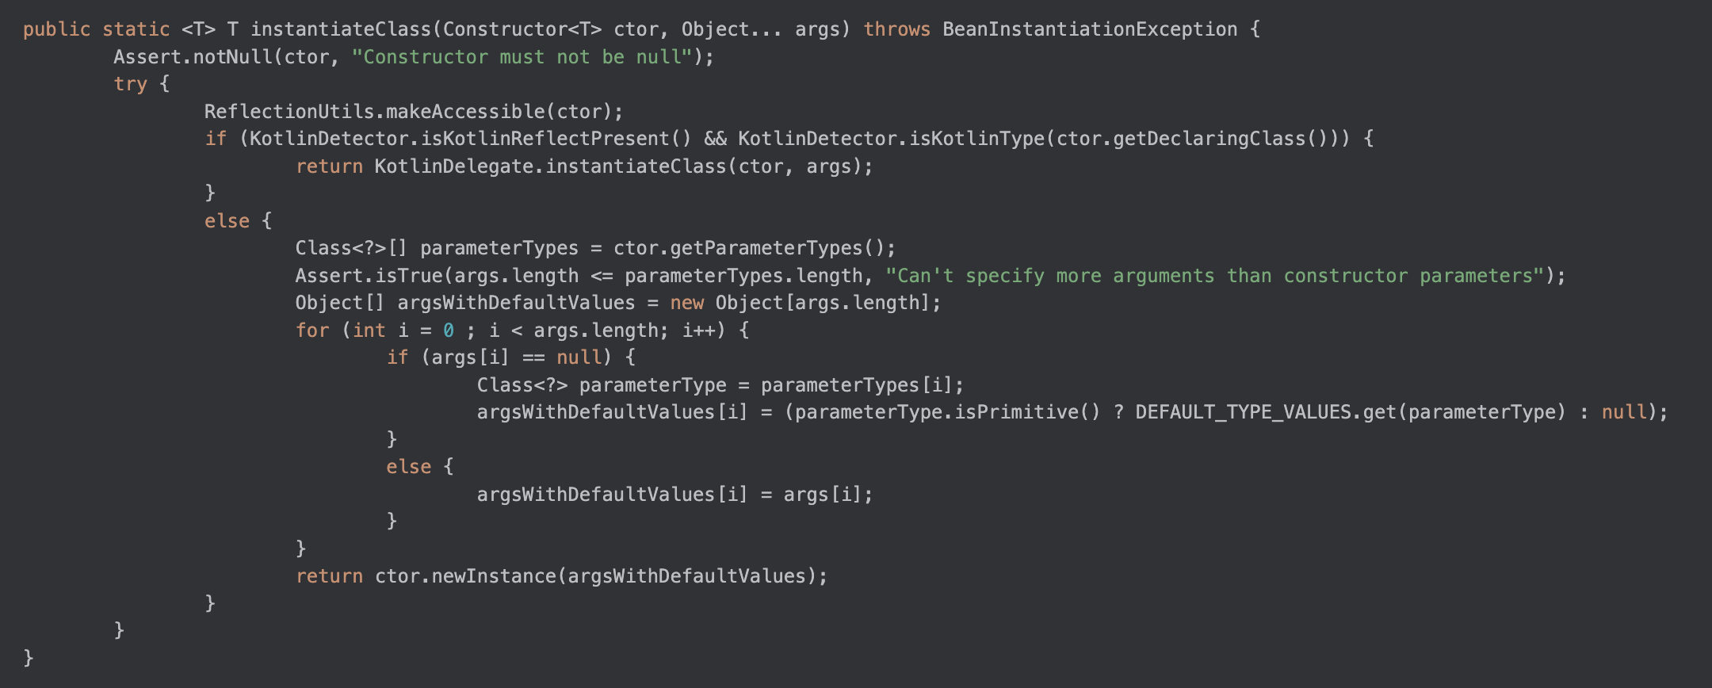
Create a new objet
Back
class:org.springframework.beans.BeanUtils

Slide 5
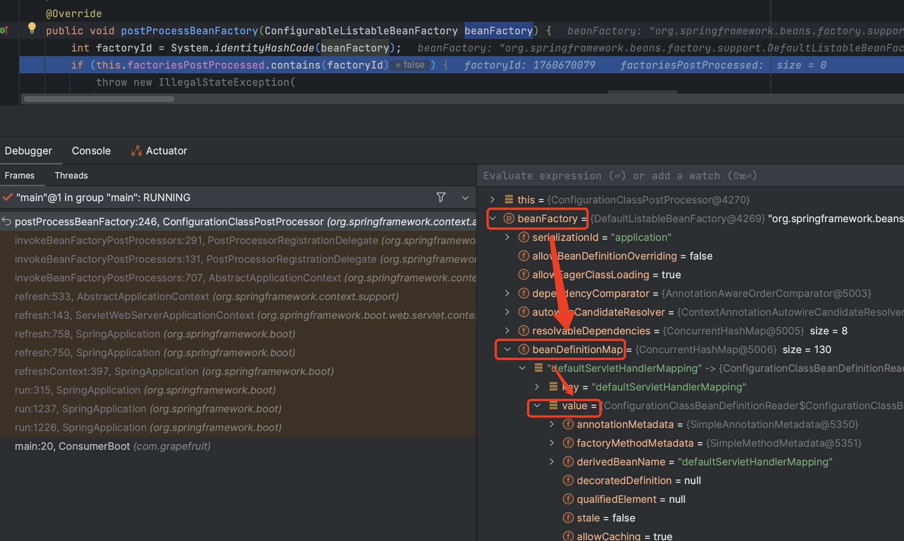
BeanDefinationMap
Back

Slide 6
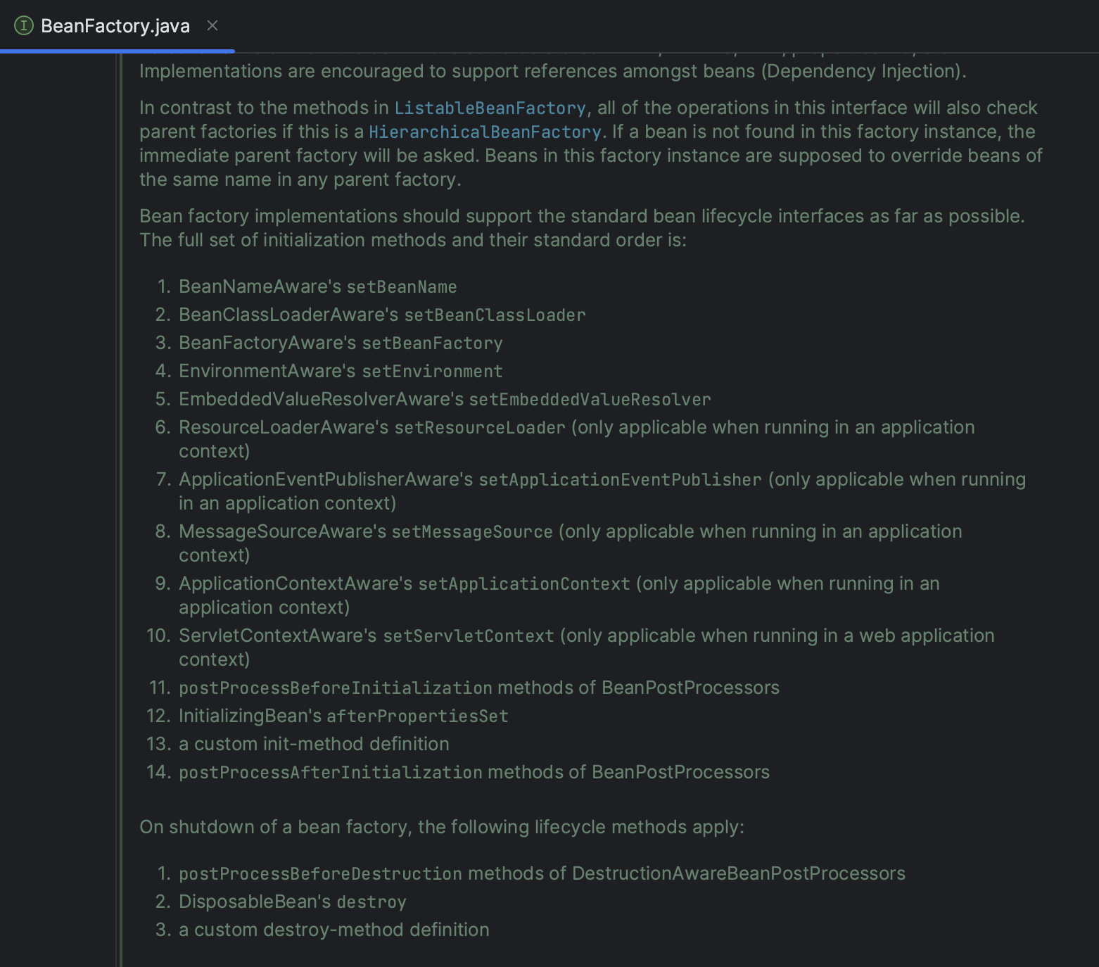
BeanFactory
Back

Slide 7
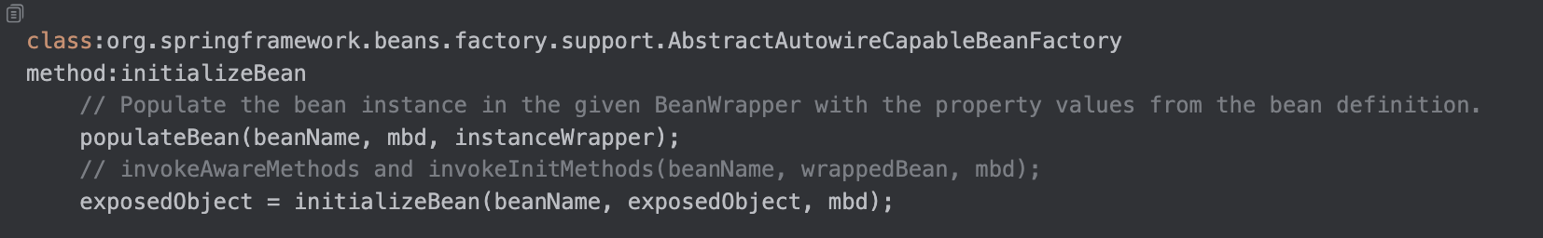
Populate and Initialize
Back

Slide 8
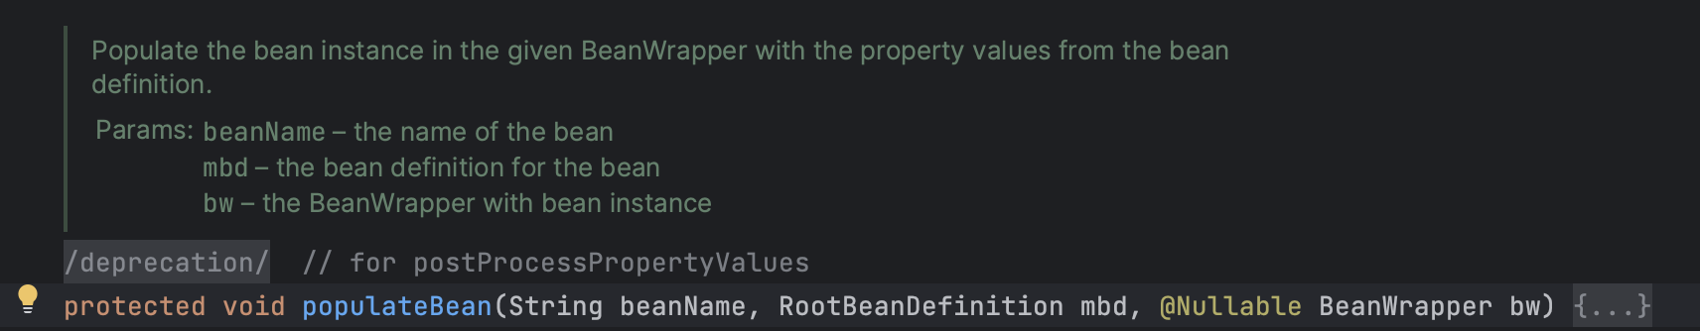
populateBean
Back

Slide 9
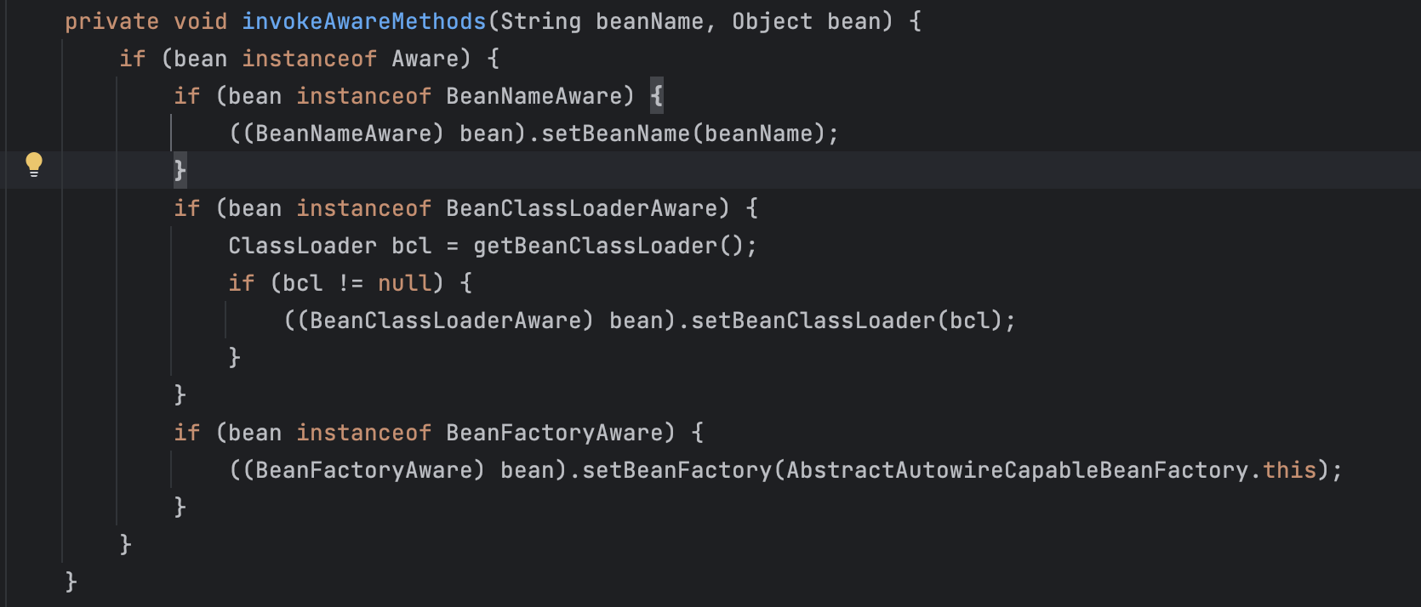
invokeAwareMethods
Back

Slide 10
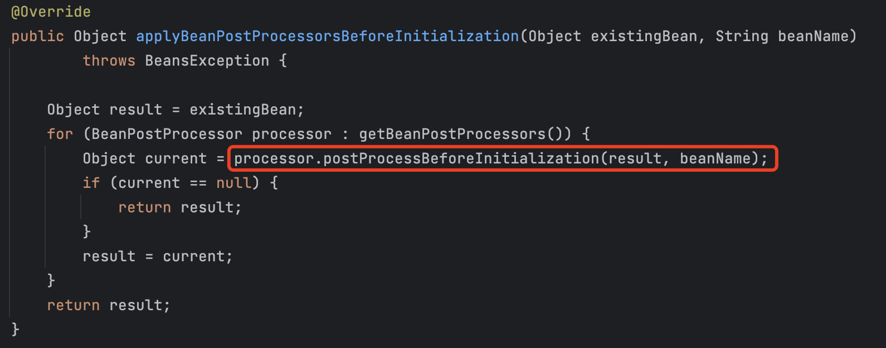
applyBeanPostProcessorsBeforeInitialization
Back

Slide 11
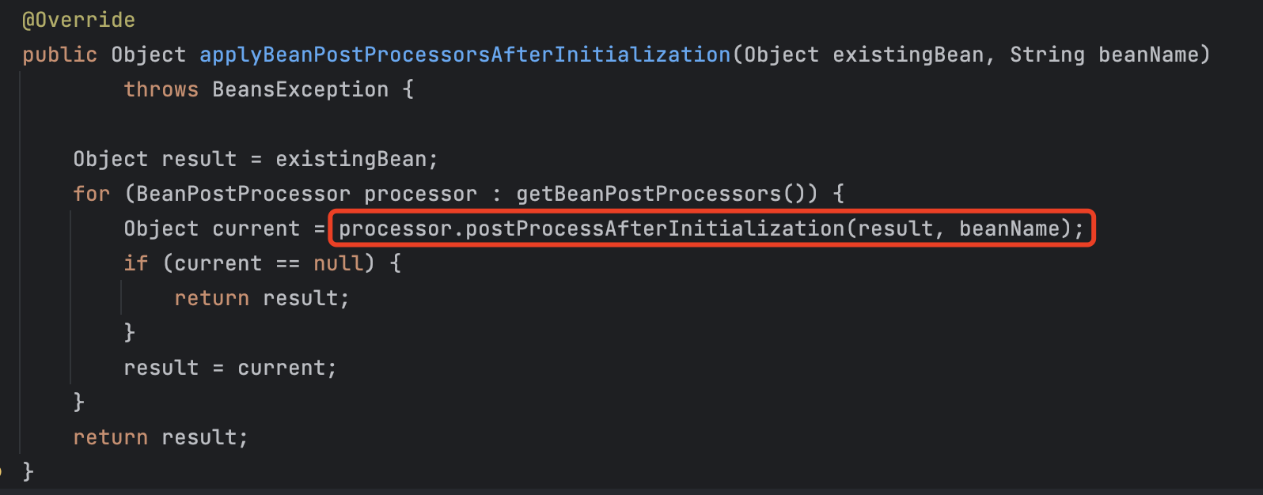
applyBeanPostProcessorsAfterInitialization
Back

Slide 12
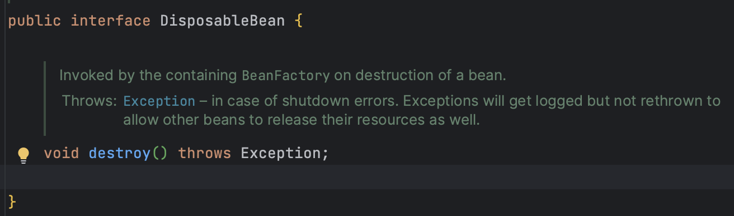
destroy
Back

